Slide 1
Archaea lecture taken by Mrs. Shinjini Dhar Halder
Date : 14/01/2021

Slide 2
Archaea
Archaea can be spherical, rod, spiral, lobed, rectangular or irregular in shape. An unusual flat, square-shaped species that lives in salty pools has also been discovered. Some exist as single cells, others form filaments or clusters.
Until the 1970s this group of microbes was classified as bacteria.

Slide 3
General Characteristics :
Archaea are unicellular, prokaryotic microorganisms that differ from bacteria in their genetics, biochemistry, and ecology.
Some archaea are extremophiles, living in environments with extremely high or low temperatures, or extreme salinity.
Only archaea are known to produce methane. Methane-producing archaea are called methanogens.
Halophilic archaea prefer a concentration of salt close to saturation and perform photosynthesis using bacteriorhodopsin.
Archaeal membrane lipids are ether-linked and may form bilayers or monolayers

Slide 4
General Characteristics :
Archaeal cell walls may consist of pseudomurein or proteinaceous S-layers
Archaea may be infected by viruses.
Many unique proteins are encoded by archaea, many of these proteins have unknown functions.
Introns are more rare than eukaryotic species, and additionally unlike eukaryotes the introns usually do not reside in protein coding genes but rather rRNA and tRNA.
Some archaea, based on fossil evidence, are among the oldest organisms on earth.
Archaea do not live in great numbers in human microbiomes and are not known to cause disease.

Slide 5
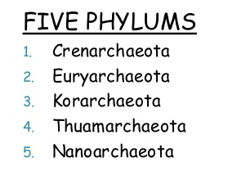
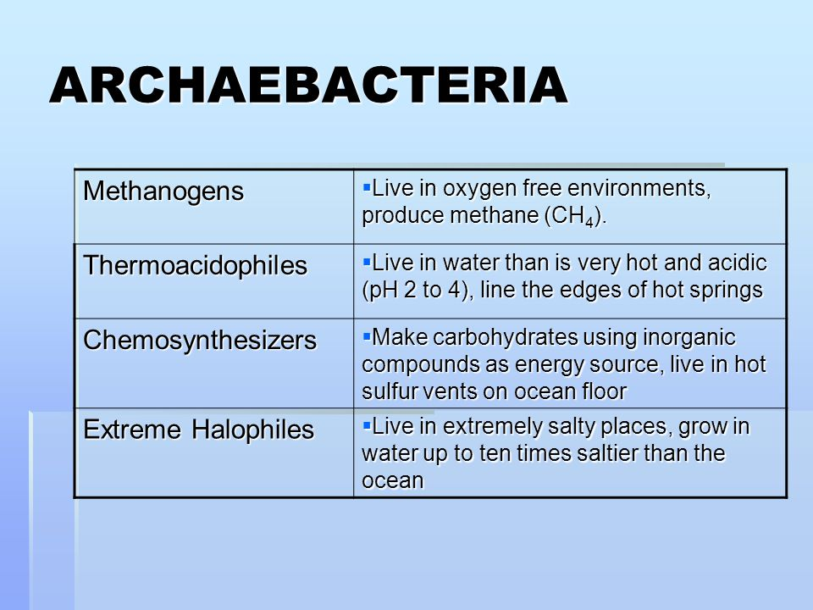
Phylogenetic classification and physiological classification :

Slide 6
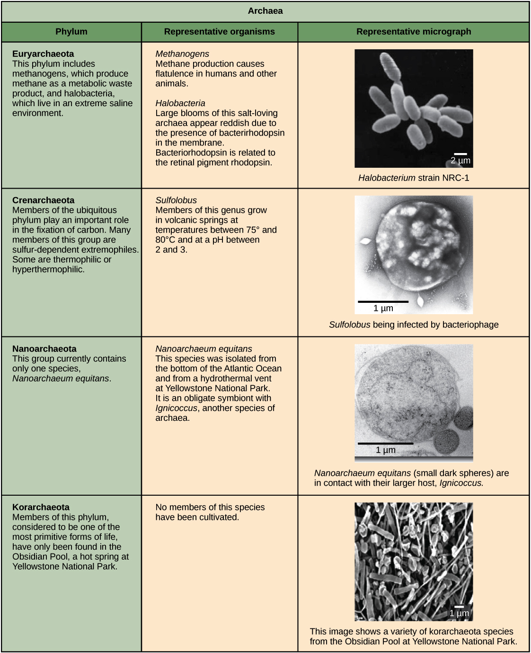

Slide 7
Physiological classification of archaea:
Halophilic or halophiles -
are archaebacteria that lives in extreme salty environment.
Can grow well in culture media containing 25–35% of NaCl
In sunlight, they develop a pigmented membrane to trap sunlight for the synthesis of ATP.
Mode of nutrition - Chemoautotrophs.
Thermoacidophilic - bacteria that survives extreme acidic condition ( pH as low as 2) and hogh temperature condition ( as high as 80 degree).
Methanogens:
Anaerobic bacteria, found in rumen of cattle and marshy area.
Produces methane gas.
Chemoautotrophs.

Slide 8
Importance of Archaebacteria
The importance of archaebacteria can be understood from the following points:
Archaebacteria have compelled the scientists to reconsider the common definition of species. Species are a group with gene flow within its members. The archaebacteria exhibit gene flow across its species.
The Archaebacteria are methanogens, i.e., they are capable of producing methane. They act on the organic matter and decompose it to release methane which is then used for cooking and lighting.

Slide 9
Importance of Archaebacteria
Because of their tolerance to high temperatures and relatively extreme environments, some members of the domain have already been exploited for a wide variety of commercial uses.These Archaea become the source of enzymes that are usually added to detergents in order to help it maintain its activity even at higher temperature and pH.
Some enzymes from Archaea are also used to convert cornstarch into the fiber dextrin.

Slide 10
Importance of Archaebacteria
Some Archaea also bear the potential for bioremediation or help in cleaning contaminated sites.
The thermophilic Archaea, Thermus aquaticus, is an essential part of the development of molecular biology as a science. As a result, Archean has become the source of the enzyme harnessed as the basis for the amplification of the DNA in a technique called Polymerase Chain Reaction (PCR).

